Slide 1
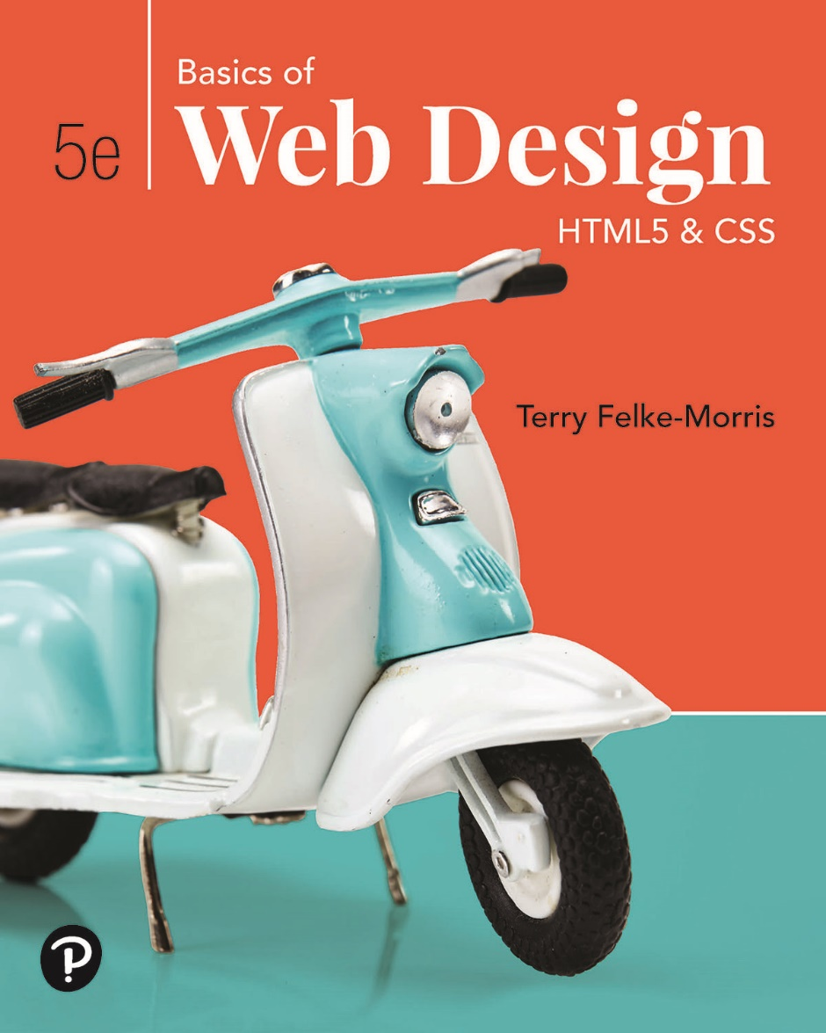
Basics of Web Design
Fifth Edition
Chapter 5
Graphics & Text Styling Basics Key Concepts
Slide in this Presentation Contain Hyperlinks. JAWS users should be able to get a list of links by using INSERT+F7
Copyright © 2019 Pearson Education, Inc. All Rights Reserved
Notes:
If this PowerPoint presentation contains mathematical equations, you may need to check that your computer has the following installed:
1) Math Type Plugin
2) Math Player (free versions available)
3) NVDA Reader (free versions available)

Slide 2
Learning Outcomes
Describe types of graphics used on the Web
Apply the image element to add graphics to web pages
Configure images as backgrounds on web pages
Configure images as hyperlinks
Configure multiple background images with C S S 3
Configure text typeface, size, weight, and style with C S S
Align and indent text with C S S
Configure list markers with C S S
Configure an image map

Slide 3
Types of Graphics
Graphic types commonly used on web pages:
G I F
J P G
P N G

Slide 4
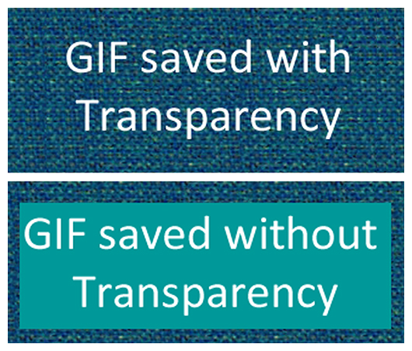
G I F
Graphics Interchange Format
Best used for line art and logos
Maximum of 256 colors
One color can be configured as transparent
Can be animated
Uses lossless compression
Can be interlaced

Slide 5
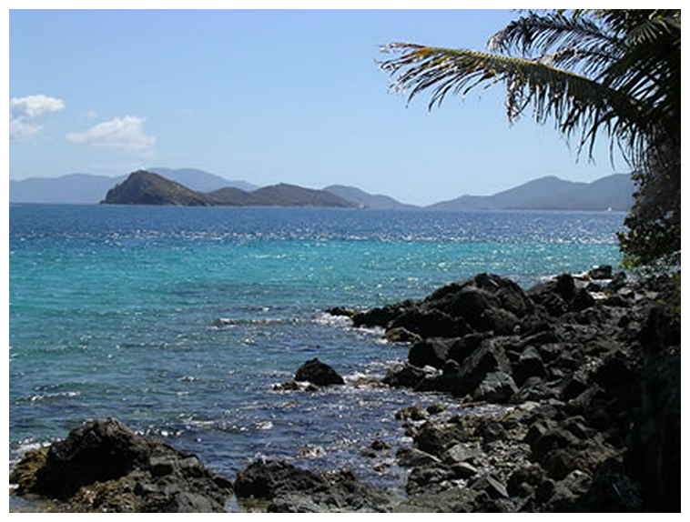
J P E G
Joint Photographic Experts Group
Best used for photographs
Up to 16.7 million colors
Use lossy compression
Cannot be animated
Cannot be made transparent
Progressive J P E G – similar to interlaced display

Slide 6
P N G
Portable Network Graphic
Support millions of colors
Support multiple levels of transparency
(but browsers do not -- so limit to one transparent color for Web display)
Support interlacing
Use lossless compression
Combines the best of G I F & J P E G
Browser support is growing

Slide 7
Web Graphics
Image Type | File Extension | Compression | Transparency | Animation | Colors | Progressive Display
Graphic Interchange Format (G I F) | .gif | Lossless | Yes | Yes | 256 | Inter-lacing
Joint Photographic Experts Group (J P E G) | .jpg or .jpeg | Lossy | No | No | Millions | Progressive
Portable Network Graphic (P N G) | .png | Lossless | Yes (multiple levels) | No | Millions | Inter-lacing

Slide 8
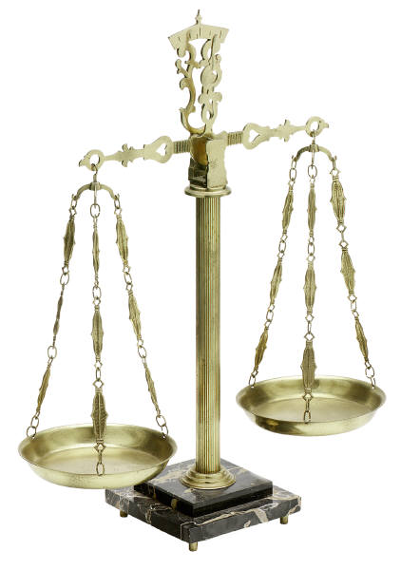
Image Optimization
The process of creating an image with the lowest file size that still renders a good quality image—balancing image quality and file size.
Photographs taken with digital cameras are not usually optimized for the Web
Use a graphics application to:
Reduce image dimensions
Reduce size of the image file

Slide 9
Optimize An Image for the Web
Image Optimization
Reduce the file size of the image
Reduce the dimensions of the image to the actual width and height of the image on the web page.
Image Editing Tools:
G I M P (free!)
Adobe Photoshop
http://pixlr.com/editor (free!)

Slide 10
Choosing Names for Image Files
Use all lowercase letters
Do not use punctuation symbols and spaces
Do not change the file extensions
(should be .gif, .jpg, .jpeg, or .png)
Keep your file names short but descriptive
i1.gif is probably too short
myimagewithmycamelonmybirthday.gif is too long
camelbday.gif may be just about right

Slide 11
The Image Element <img>
Configures graphics on a web page
<img src="cake.gif" alt="birthday cake" height="100" width="100">
src Attribute
File name of the graphic
alt Attribute
Configures alternate text content (description)
height Attribute
Height of the graphic in pixels
width Attribute
Width of the graphic in pixels

Slide 12
Accessibility & Images
Required:
Configure the alt attribute
Alternate text content to convey the meaning/intent of the image
If the image contains a text message, then the text should typically be the value of the alt attribute
NOT the file name of the image
Use alt=“” for purely decorative images
Recommended:
If your site navigation uses image links for the main navigation, provide simple text links at the bottom of the page.

Slide 13
Image Links
To create an image link use an anchor element to contain an image element
<a href="index.html"><img src="home.gif" height="19" width="85" alt="Home"></a>
Browsers automatically add a border to image links.
Configure C S S to eliminate the border
img {border-style: none; }

Slide 14

Thumbnail Image
A small image configured to link to a larger version of that image.
<a href="large.jpg"><img src="small.jpg" alt=“ocean view of island” width="200" height="100"></a>

Slide 15
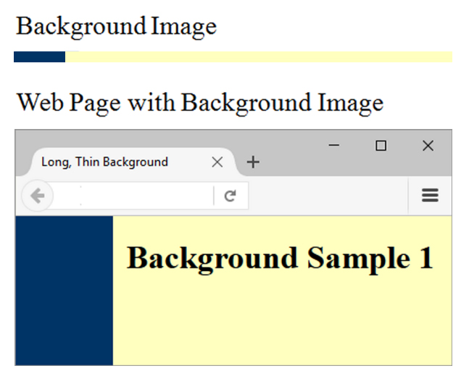
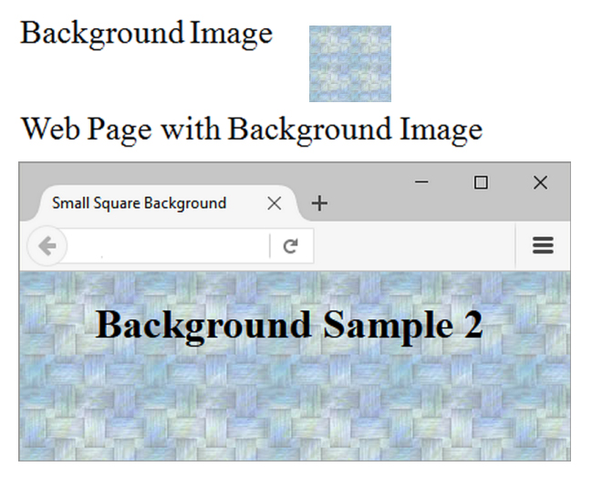
C S S background-image Property
Configures a background-image
By default, background images tile (repeat)
body { background-image: url(background1.gif); }

Slide 16
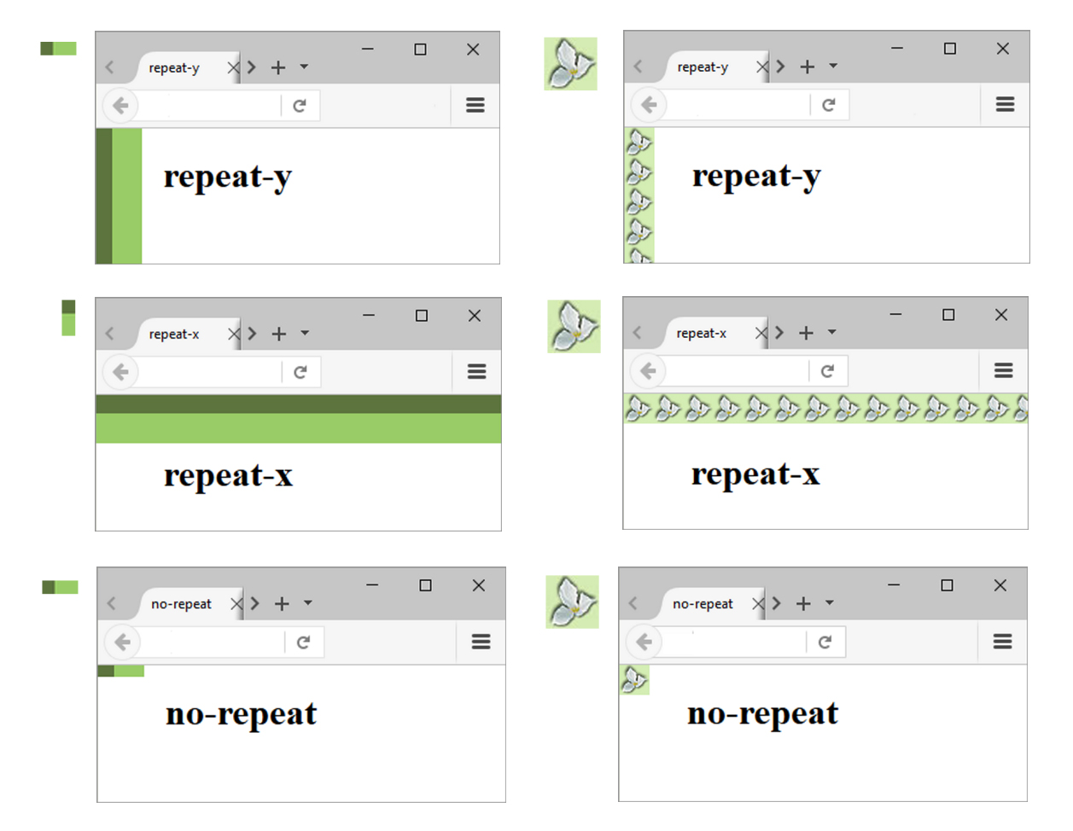
C S S background-repeat Property

Slide 17

Using background-repeat
trilliumbullet.gif:
h2 { background-color: #d5edb3;
color: #5c743d;
padding-left: 30px;
background-image: url(trilliumbullet.gif);
background-position: right;
background-repeat: no-repeat;
}

Slide 18
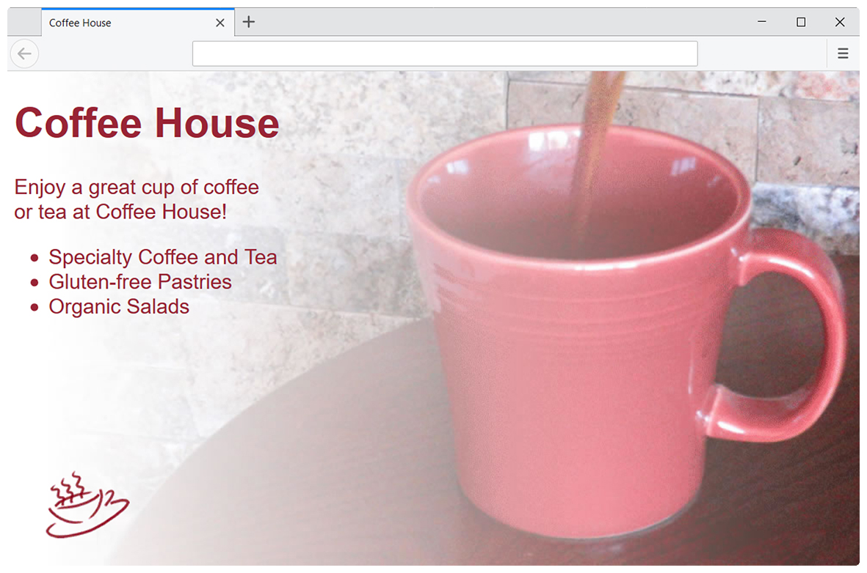
Multiple Background Images
body { background-image: url(coffeepour.jpg); background-repeat: no-repeat; background: url(coffee.gif) no-repeat left bottom, url(coffeepour.jpg) no-repeat; }

Slide 19
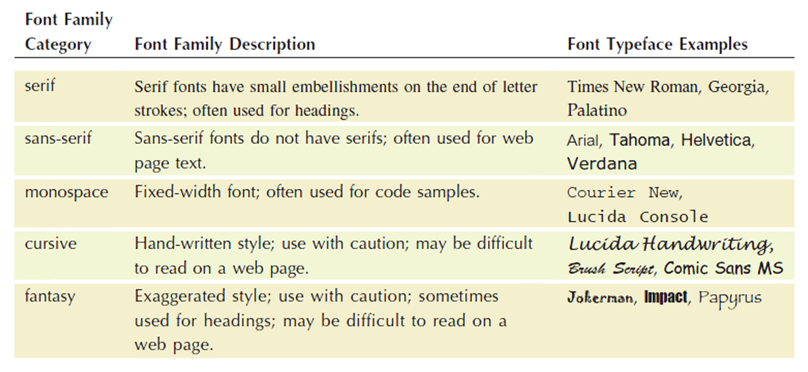
Configure Typeface with C S S
font-family property
Configures the font typeface of the text
Include a generic family name
p { font-family: Verdana, Arial, sans-serif; }

Slide 20
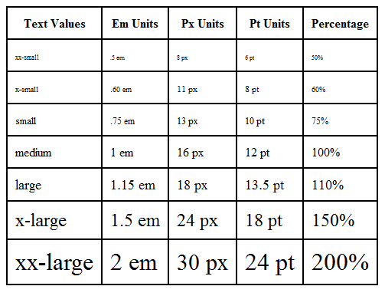
The font-size Property
Configures the size of text
p { font-size: 90%; }

Slide 21
Align and Indent Text with C S S
text-align property
Configures the alignment of text
h1 { text-align: center; }
text-indent property
Configures the indentation of the first line of text in an element
p { text-indent: 5em; }

Slide 22
More C S S Text Properties
font-weight property
Configures the boldness of text
font-style property
Configures the style of the text
line-height property
Modifies the height of a line of text
text-decoration property
Modifies the display of text Typically used to remove the default underline from hyperlinks
text-transform property
Configures the capitalization of text
letter-spacing property
Configures the space between text characters
li {font-weight: bold; }
#special { font-style: italic; }
p { line-height: 120%; }
a { text-decoration: none; }
h3{ text-transform: uppercase; }
h1 { letter-spacing: 3px; }

Slide 23
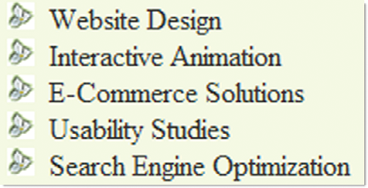
Configure List Markers with C S S
C S S Properties
list-style-type
list-style-image
list-style position
Example:
ul {list-style-image: url(trillium.gif); }

Slide 24
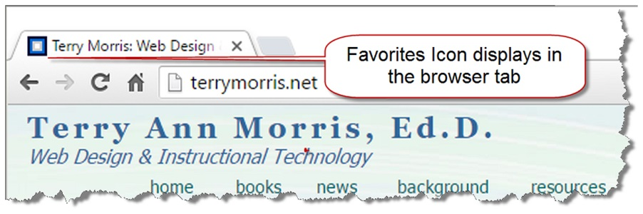
Favorites Icon
Small icon that displays in the address bar or tab bar of some browsers
Also called a favicon
<link rel="icon" href="favicon.ico" type="image/x-icon">

Slide 25
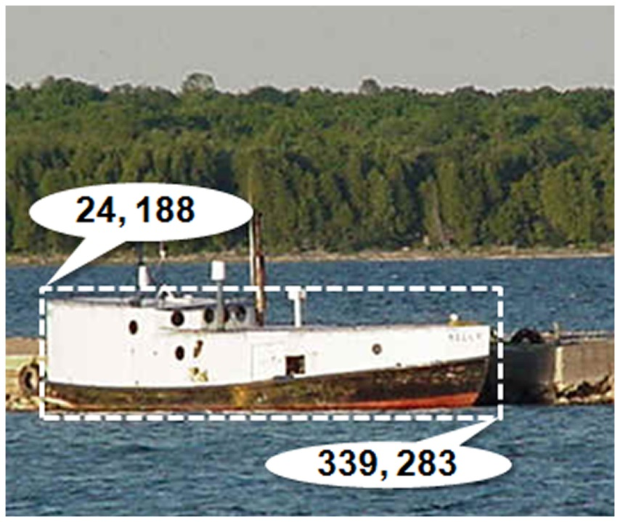
Image Map
map element
Defines the map
area element
Defines a specific area on a map
Can be set to a rectangle, circle, or polygon
href Attibute
shape Attribute
coords Attribute
<map name="boat" id="boat">
<area href="http://www.doorcountyvacations.com" shape="rect" coords="24, 188, 339, 283" alt="Door County Fishing">
</map>
<img src="fishingboat.jpg" usemap="#boat" alt="Door County“ width="416" height="350">

Slide 26
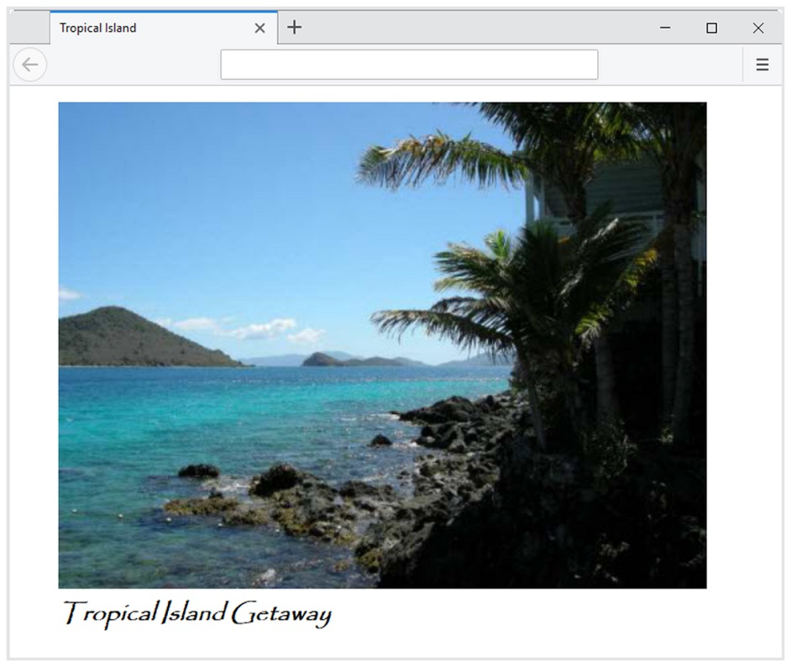
Figure and Figcaption Elements
The Figure Element
Block display
Comprises a unit of content that is self-contained, such as an image, along with one optional figcaption element.
The Figcaption Element
Block display
Provides a caption for the figure content

Slide 27
Summary
This chapter introduced the H T M L techniques and technologies used to place images and configure text on web pages.
Issues related to accessibility and images were also discussed.
The number one reason for visitors to leave web pages is too long of a download time. When using images, be careful to minimize this issue.

Slide 28

Copyright
This work is protected by United States copyright laws and is provided solely for the use of instructors in teaching their courses and assessing student learning. Dissemination or sale of any part of this work (including on the World Wide Web) will destroy the integrity of the work and is not permitted. The work and materials from it should never be made available to students except by instructors using the accompanying text in their classes. All recipients of this work are expected to abide by these restrictions and to honor the intended pedagogical purposes and the needs of other instructors who rely on these materials.

